Slide 1




MIP-DA-04 Power BI
INDIAN AGRICULTURE ANALYSIS
Harsh Tantak

Slide 2
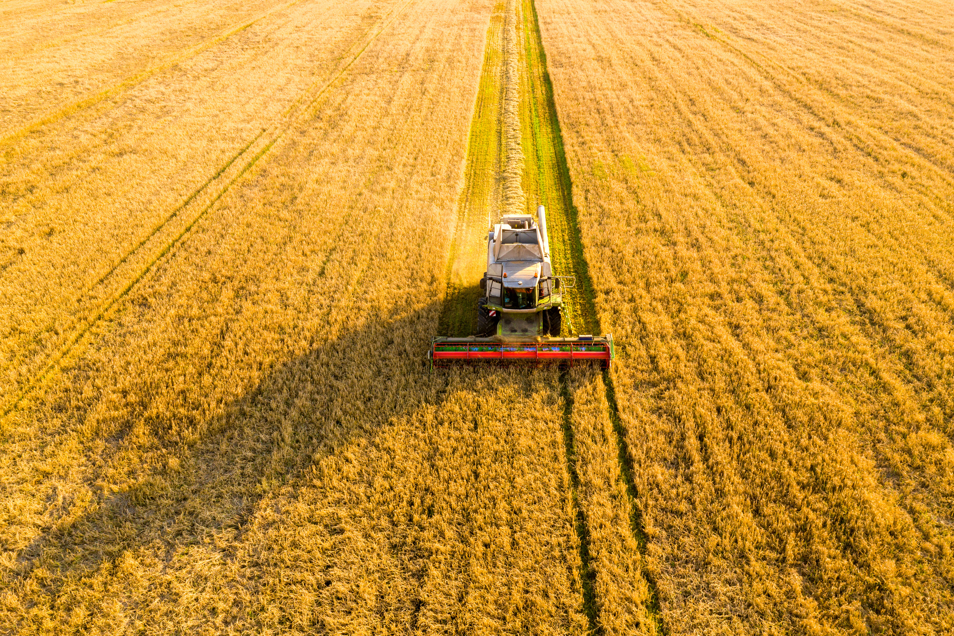
Content
01
Overview
02
Dataset Overview
03
Transforming Data
04
Data Modelling
05
Visualiazation
06
Conclusion

Slide 3





Overview
Indian agriculture is pivotal to the economy, sustaining millions and ensuring food security. Its diverse crops thrive in varied climates, soil, and water resources. Major produce includes cereals, pulses, oilseeds, fruits, and vegetables. Rice, wheat, maize, millets, pulses, and sugarcane are prominent, alongside a rich horticultural variety.
Problem Statement
This project aims to analyze Indian agriculture using district-wise and year-wise data. The dataset contains detailed information on crops, areas, production, and yields across districts and years. Utilizing Power BI, interactive visualizations will be created to uncover trends and patterns in agricultural practices. This will aid stakeholders in making informed decisions for sustainable farming and resource allocation.

Slide 4


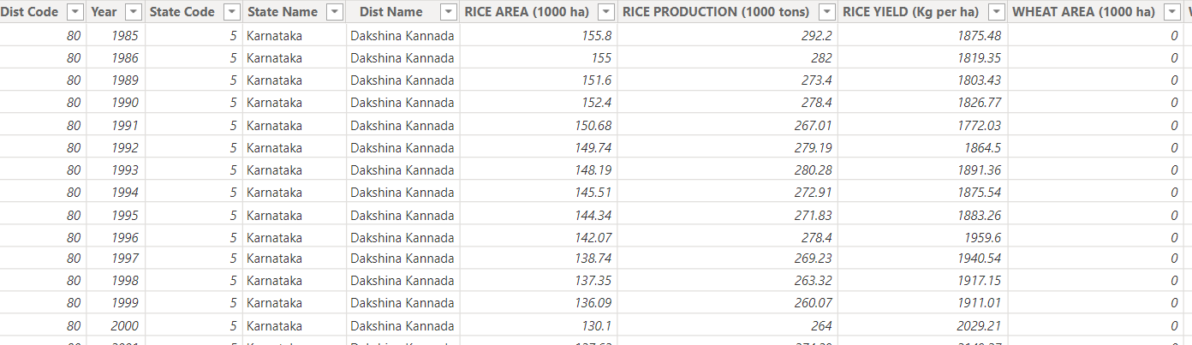
Dataset Overview
Area: The land area used for cultivating a crop measured in thousand hectares (ha).
Production: The quantity of crop harvested from the cultivated area measured in thousand tons.
Yield: The efficiency of crop production, representing the amount of crop harvested per unit area of land typically measured in kilograms per hectare (Kg/ha).

Slide 5
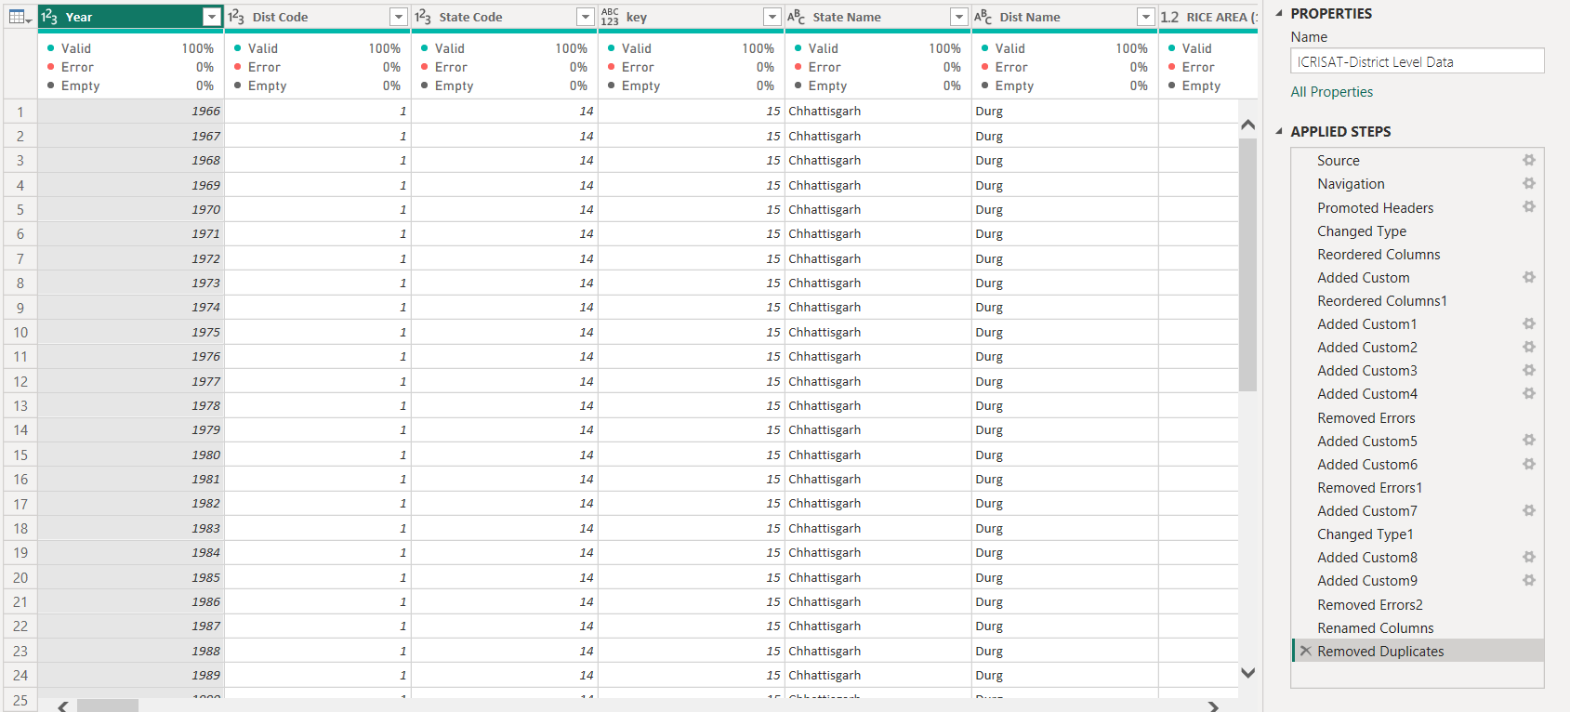
Transforming Data
Transofrming Data in Power Query

Slide 6
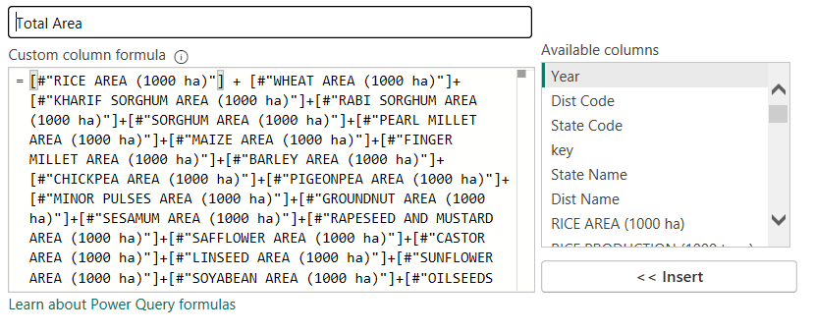
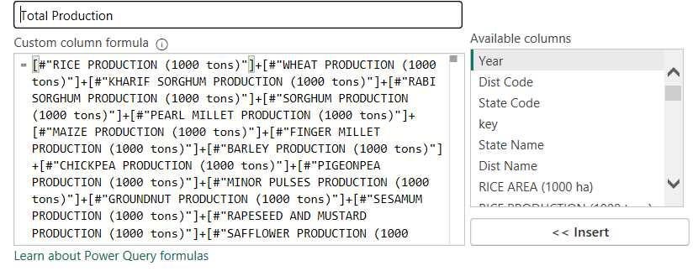
Transforming Data
Creating Custom Columns

Slide 7
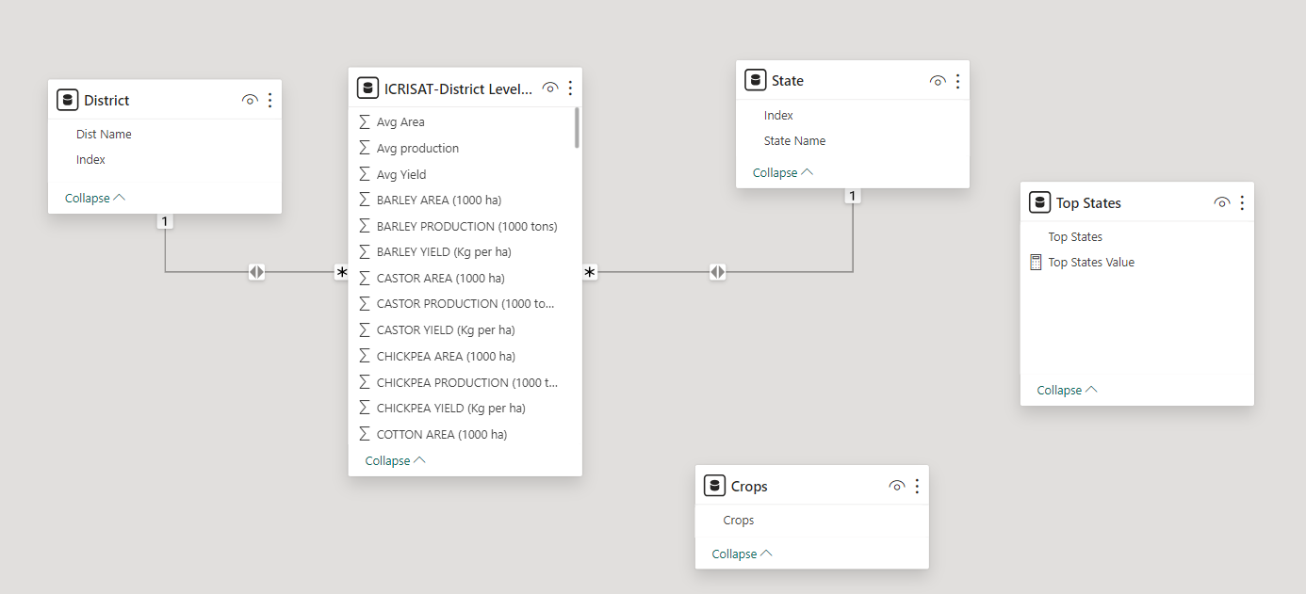
Data Modelling
Creating Relationships with Index tables

Slide 8

VISUALIZATION
Briefly discuss the key performances of the project.

Slide 9

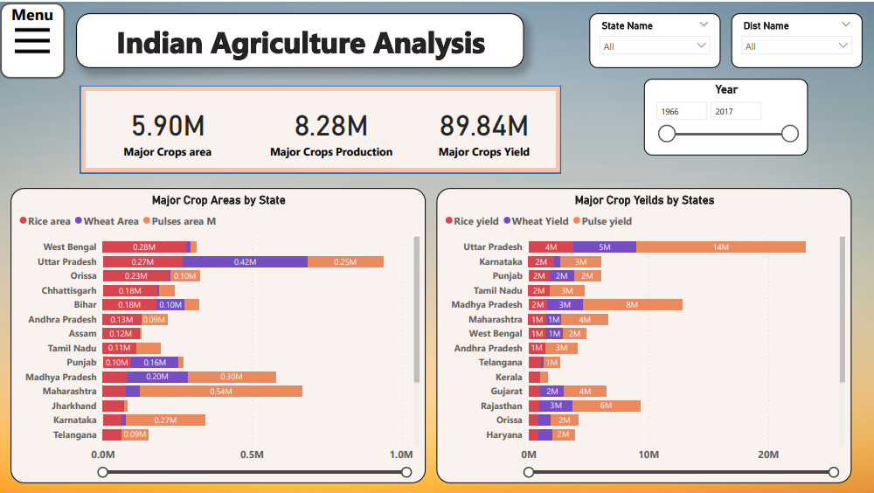
Major Crop Analysis

Slide 10
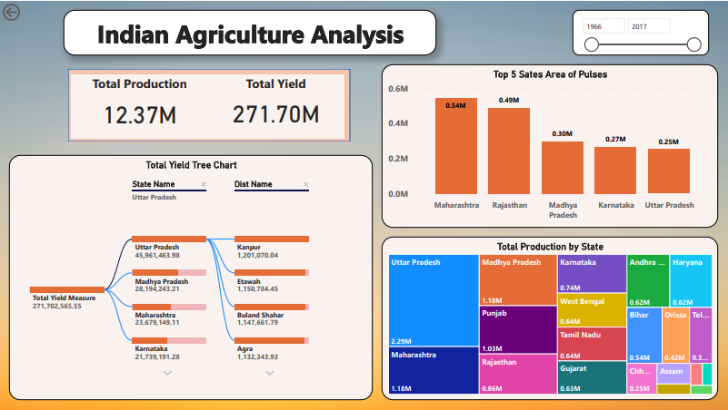
Regional Disparities

Slide 11
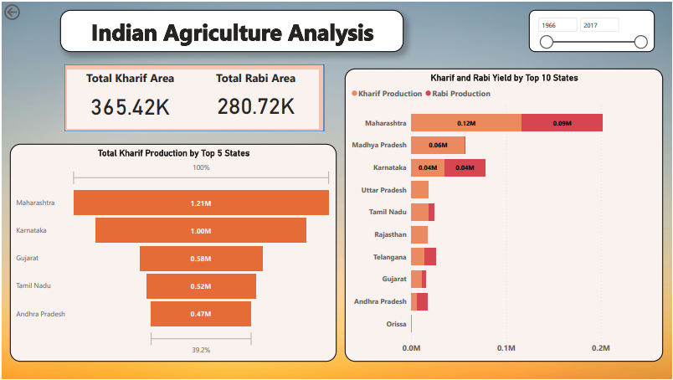
Seasonal Analysis

Slide 12
Seasonal Analysis

Slide 13
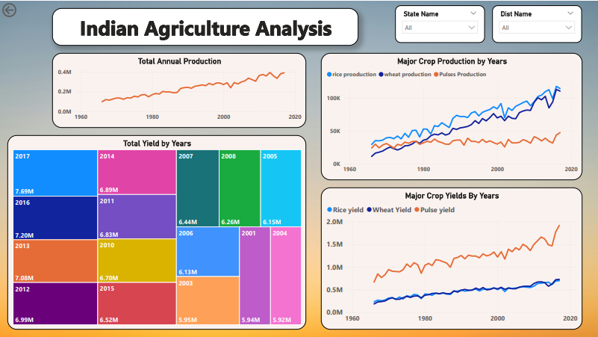
Impact of External Factors

Slide 14
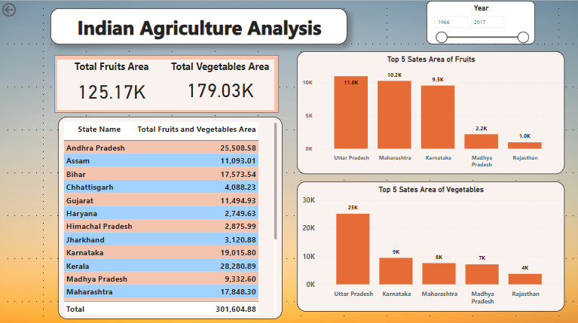
Fruits and Vegetable Analysis

Slide 15
Recommendations
Promote crop diversification: Encourage farmers to cultivate a variety of high-value crops beyond staples like rice and wheat, focusing on fruits, vegetables, and pulses.
Support modern practices: Assist farmers in adopting modern techniques such as precision farming and drip irrigation to increase productivity and sustainability.
Improve storage and transport: Enhance post-harvest infrastructure to reduce wastage, ensure quality, and facilitate better market prices.
Provide training services: Offer farmers training and extension services to learn effective crop management and pest control methods.
Invest in research: Allocate resources for agricultural research to develop resilient crop varieties and sustainable farming practices tailored to local conditions.
Encourage organic farming: Promote organic farming to meet consumer demand for chemical-free produce and improve long-term soil health.
Enhance market access: Establish farmer producer organizations and strengthen market linkages to enable wider market access and fair prices for farmers' produce.

Slide 16
Conclusion
In conclusion, the Indian Agriculture Data Visualization project in Power BI equips stakeholders with actionable insights, fostering improvements in agricultural productivity, resilience, and sustainability. With intuitive visualizations, stakeholders can navigate complexities, make informed decisions, and advance Indian agriculture effectively.

Slide 17
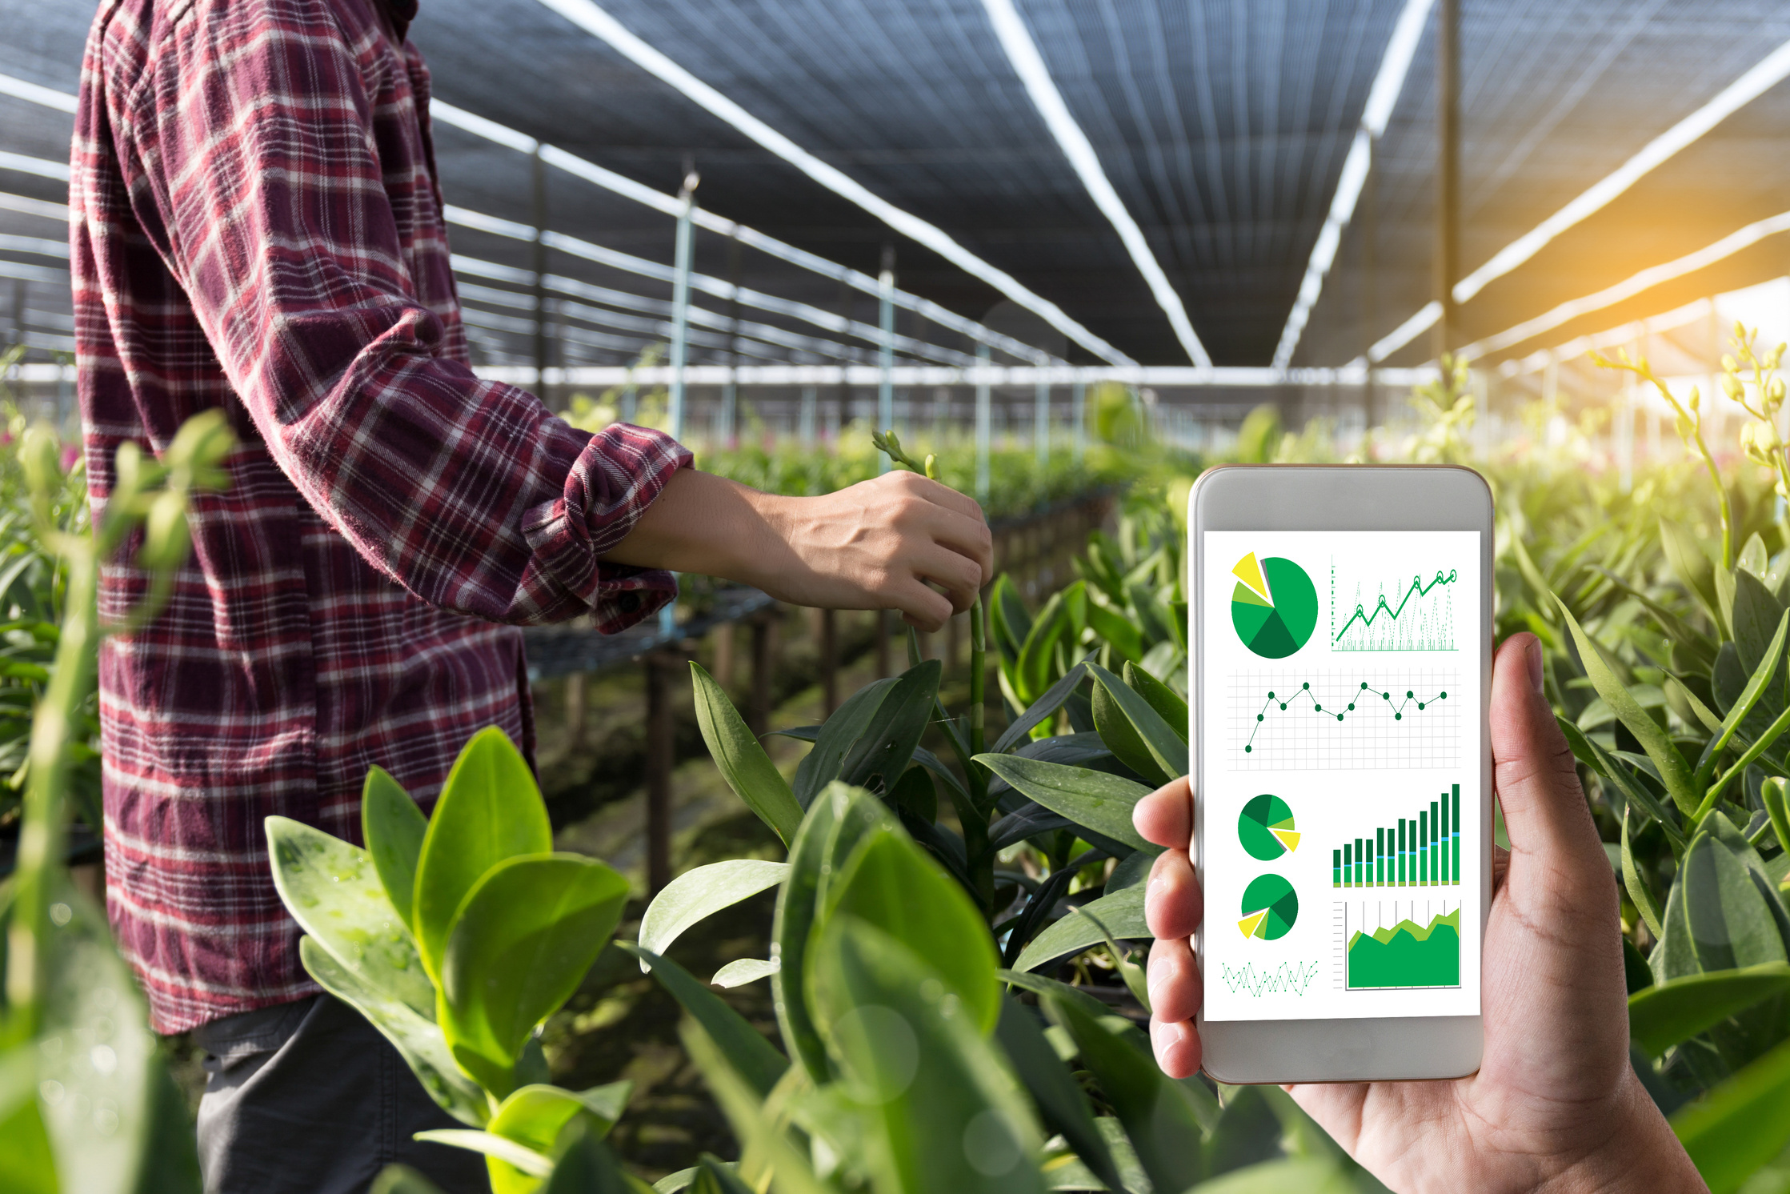
THANK YOU
Harsh Tantak
Do check out this Interactive Dashboard on the given link

